Slide 1
Capstone Packet Capture Analysis

Slide 2
Agenda
Background Information
Accessing the Data
Cleaning Data
Analysis of Fields
Report on Findings

Slide 3
Background Information
Internet Protocol (IP) packets captured via Packet Capture (PCAP) tool on 11/12/2012.
Final aggregated table contains 1,356 columns and 10,880 rows.
14,753,280 total data points
Notes:
The subject of my analysis is a set of captured Internet Protocol (IP) packets from 11/12/2012. These are Operational Technology (OT) packets that utilize Common Industrial Protocol (CIP).
They were captured by a PCAP tool. I don’t know which tool was used to capture these packets, but I use Wireshark. After aggregating the data, which we will discuss in more detail coming up, the final CSV file contained 1356 columns across 10,880 individual packets for a grand total of 14,753,280 data points. A real mouthful, right? To work with this much data, we’ll to know which columns contain the answers to our questions.

Slide 4
What We Want to Know
How many participants are in the conversation?
Were there any errors in the packets?
Checksums
Explicit Congestion Notification (ECN)
What is the average latency across the network?
Notes:
Checksums ensure data integrity from the source to the destination. ECN is a result of too much traffic on the network.

Slide 5
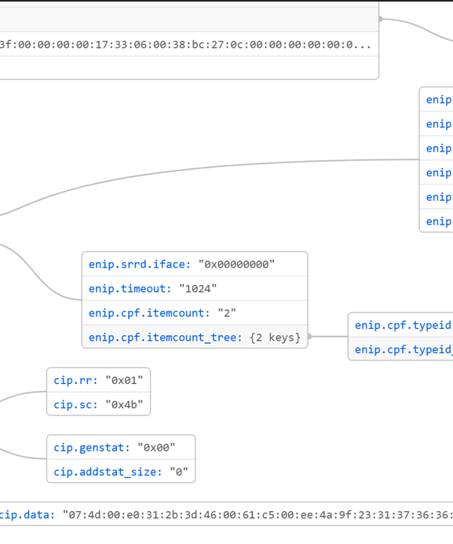
Accessing the Data
Pcap -> json -> CSV -> SQL

Slide 6
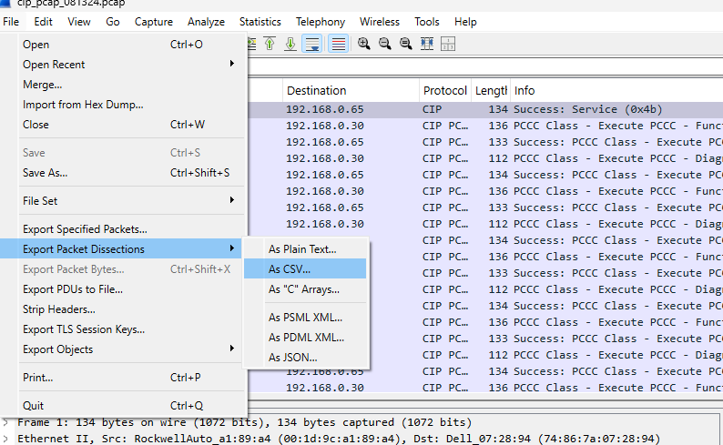
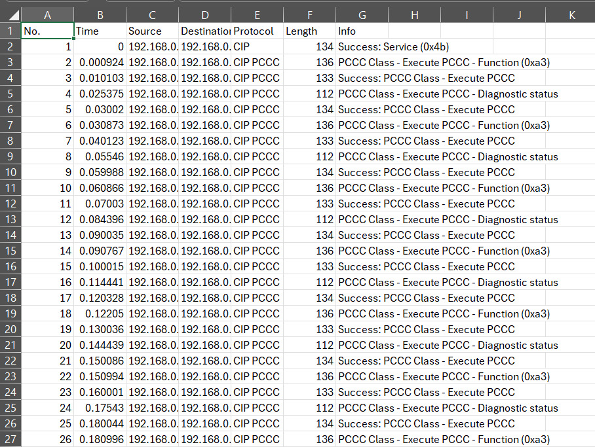
PCAP to JSON
PCAP files can be exported from Wireshark directly as a Comma Separated Value (CSV) file.
This does not offer much information.
Wireshark offers the option to export as Java Script Object Notation (JSON) as well.
Notes:
As seen in the first figure, Wireshark can export packet captures as a CSV. This doesn’t offer a wealth of information. For a deeper dive, you can use the output as JSON option.

Slide 7
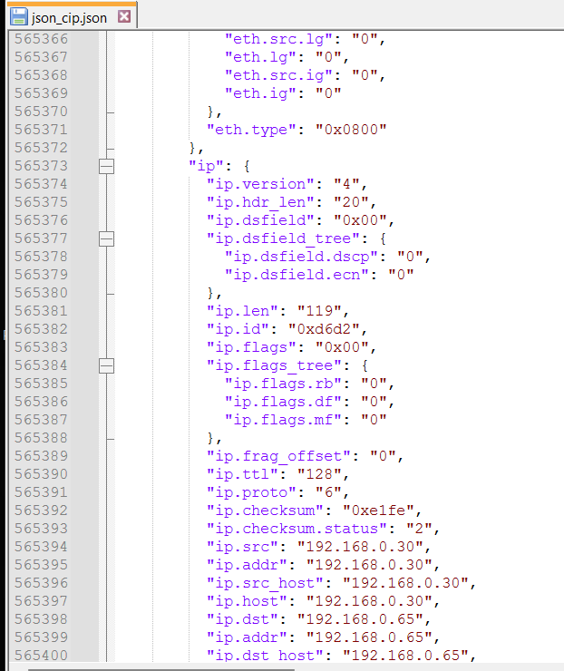
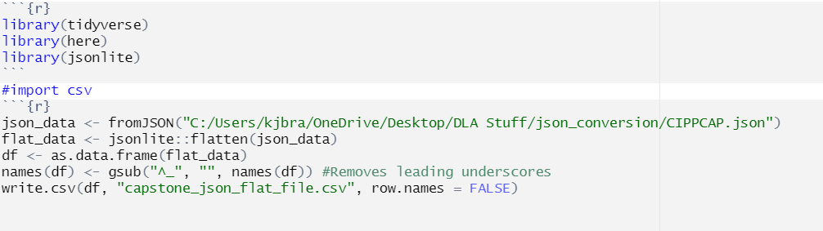
JSON to CSV
The JSON file is nested.
The R code chunk pictured below will “flatten” the file and export it to CSV.
Notes:
The nested JSON file is not easily searchable because there are many lines between each field, many of which are not relevant. The nesting also prevents the file from being easily written to CSV. To remedy this, we can use the jsonlite::flatten() function.

Slide 8
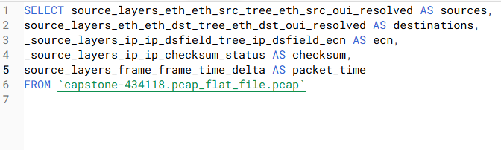
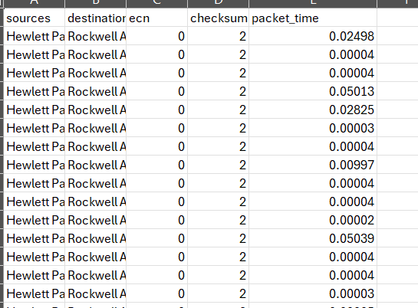
CSV to SQL
The CSV can be used to create a table in MySQL.
Made new table from SQL query to select and rename any relevant columns.
Exported table as CSV for analysis in R.
Used SQL queries to verify different counts.
Notes:
While data filtering and summarization can be done in R, SQL allows for rapidly asking new questions without making big changes to the code. As such, SQL is usually the tool I use to gain a high-level understanding of the dataset. In this case, I used SQL to create a new table that included only the necessary columns and gave them nicer names. I also used SQL queries to verify some other information. Namely, that there were 2 participants in the conversation, that over half of the packets had checksums, that no checksums returned errors, and that there were no stray UDP packets in the traffic.

Slide 9
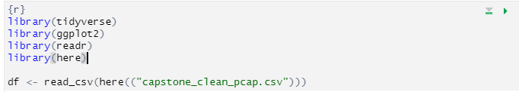
Analyzing the Data
Moved to RStudio environment for analysis and reporting.
Loaded R libraries and stripped-down data table.

Slide 10
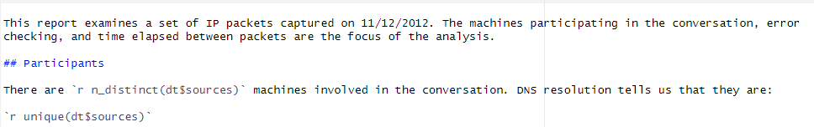
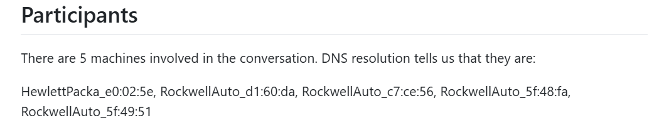
Distinguishing Participants
Used R markdown with inline code to count the number of unique IP addresses and list them.
This is the corresponding section of the report.
Notes:
Note Rmarkdown script, headings. Also note that the report template will work for any data frame with the same column names.

Slide 11
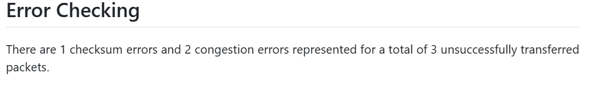
Checking for Errors
Used R inline code to find and count errors.
The resulting report section:

Slide 12

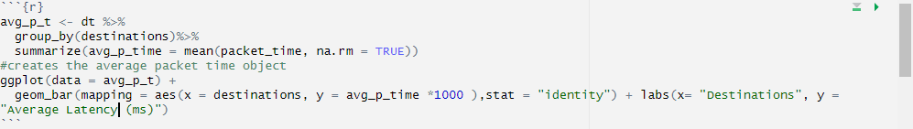
Determining Average Latency
Used R inline code to determine mean, max, and min packet latencies.
Created code chunk to display results graphically.

Slide 13
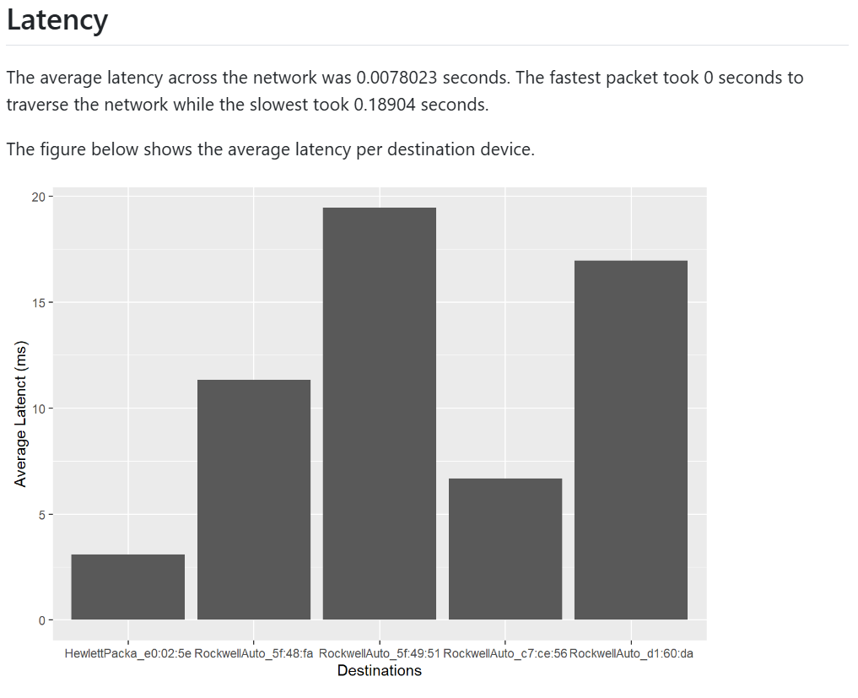
Latency Graph
This is the resulting final piece of the report.

Slide 14
Questions?

